Slide 1
Housing Incentive Overlay Zone (HIOZ) CEQA Scoping Meeting
September 28, 2023
6:00 PM

Slide 2
Agenda
Overview of HIOZ
Overview of CEQA and the EIR process
Community input on the scope of the Program EIR
Topics to evaluate
Environmental concerns
Potential alternatives and mitigation measures
Next steps and future opportunities for public input
2
Notes:
CHRIS slide
For those who aren’t joining via zoom, a copy of this PowerPoint is posted on the City’s Housing Element Update webpage

Slide 3
What is HIOZ?
HIOZ is a Housing Incentive Overlay Zone.
HIOZ would allow a property owner to develop housing on a non-residential parcel within HIOZ if a minimum percentage of affordable units are included.
HIOZ does not change the existing zoning classification of a parcel. Nor does it require the development of housing. Instead, it layers a housing zoning classification on top of existing zoning.
The property can continue operating as it does today, or it can be redeveloped/ improved within current zoning regulations. Or with HIOZ, it can be redeveloped as housing.
5
Notes:
CHRIS slide
The Housing incentive Overlay Zone or HIOZ is a proposed regulatory zoning tool
When adopted It will apply to select parcels in the city that are currently zoned for non-residential uses.
It will allow the owner of a parcel within HIOZ to opt into the overlay district and to develop housing if a minimum percentage of affordable units are included in the development
It does not not change existing zoning. Properties within HIOZ can continue operating as they do today, or they can be redeveloped/ improved within current zoning regulations (which is typically commercial or industrial zoning )
OR with HIOZ it can be redeveloped as housing.

Slide 4
Where does the HIOZ fit in?
The HIOZ is a program within the City’s Housing Element Update for 6th Cycle.
Proposed to meet the Regional Housing Needs Allocation (RHNA).
RHNA numbers are allocated to cities by the Southern California Association of Governments (SCAG) in compliance with State Housing Law.
RHNA for Fullerton is 13,209 units.
HIOZ is designed to meet the majority of the RHNA requirement.
5
Notes:
CHRIS slide

Slide 5
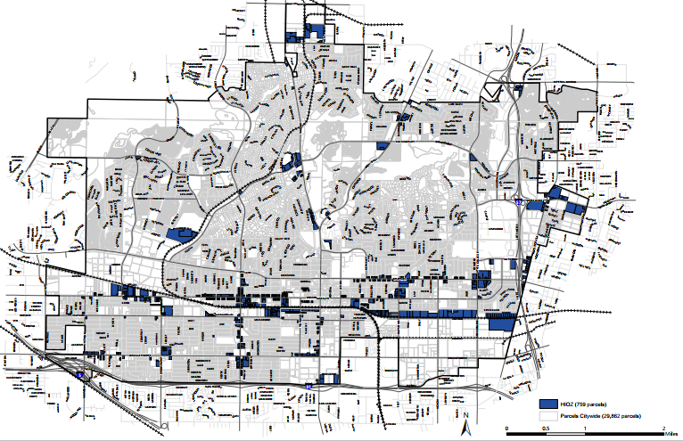
HIOZ Parcels (Planning Area)
A total of 759 parcels are identified, totaling approx. 594 acres
Described in Appendix A of the Initial Study for site inventory and buildout methodology
6
Notes:
CHRIS slide
Transition to NICOLE

Slide 6
What is CEQA?
The California Environmental Quality Act (CEQA) was enacted in 1970.
CEQA requires state and local agencies to evaluate and consider environmental impacts during the decision-making process.
CEQA informs decision makers and the public about the proposed project and potential environmental impacts.
CEQA provides an opportunity for the public and agencies to comment on the environmental issues.
CEQA identifies ways to avoid or reduce environmental impacts through mitigation and/or project alternatives.
Notes:
NICOLE

Slide 7
What is an EIR?
An EIR is an informational document provided to decision makers and the public, circulated for public review for a minimum of 45 days upon release of the Notice of Availability (NOA).
An EIR contains an analysis on environmental topics determined to result in potentially significant impacts.
HIOZ will be analyzed under a Program EIR, as defined under Section 15168 of the CEQA Guidelines.
The City shall consider the Program EIR prior to a decision on HIOZ.
Notes:
NICOLE

Slide 8
Contents of an EIR
Project Description and Project Objectives
Environmental Setting (baseline for impact analysis)
Direct, Indirect, and Cumulative impact analyses
Ways to avoid or reduce significant environmental impacts through mitigation measures and/or project alternatives
Effects Found Not to be Significant
Organizations and Persons Consulted
Notes:
NICOLE

Slide 9
EIR Process
* Opportunities for Public Comment
1. Circulate Notice of Preparation of an EIR
2. Public Scoping
Meeting *
3. Prepare Draft EIR
6. Prepare Final EIR
5. Public Comments on Draft EIR *
4. Circulate Draft EIR for Public Review *
7. Public Agencies Provide Feedback on Final EIR
8. Planning Commission Hearing *
9. Notice of Determination Filed
(if approved)
10
Notes:
NICOLE

Slide 10
Topics Considered in the Initial Study
Aesthetics
Agriculture and Forestry Resources
Air Quality
Biological Resources
Cultural Resources
Energy
Geology and Soils
Greenhouse Gas Emissions
Hazards and Hazardous Materials
Hydrology and Water Quality
Land Use and Planning
Mineral Resources
Noise
Population and Housing
Public Services
Recreation
Transportation
Tribal Cultural Resources
Utilities and Service Systems
Wildfire
Notes:
NICOLE

Slide 11
Topics Scoped Out through Initial Study
Aesthetics
Agriculture and Forestry Resources
Biological Resources
Cultural Resources
Energy
Geology and Soils
Wildfire
Notes:
NICOLE

Slide 12
Topics for Study in the EIR
Air Quality
Greenhouse Gas Emissions
Hazards and Hazardous Materials
Hydrology and Water Quality
Land Use and Planning
Mineral Resources
Noise
Population and Housing
Public Services
Recreation
Transportation
Tribal Cultural Resources
Utilities and Service Systems
Notes:
NICOLE
EIR will also analyze cumulative impacts, alternatives, and growth inducing impacts

Slide 13
Next Steps
Receive verbal comments this evening
Review scoping comments received through Monday, October 9, 2023
Conduct environmental analysis
Identify mitigation and/or alternatives to reduce potentially significant environmental impacts
Circulate Draft Program EIR, likely in Spring 2024
Notes:
NICOLE
Encourage written comments to be submitted
Transition to CHRIS

Slide 14
Scoping Meeting Procedures
If joined online or on mobile application:
To submit a written comment
(1) Click “Q&A” (2) Type your comment (3) Click “Submit”
All meeting attendees will be muted. To submit a verbal comment
(1) Click “Raise Hand” (2) Moderator will Unmute (3) 2 minutes for comment
If joined on telephone:
To submit a verbal comment
(1) Click *9 to Raise Hand (2) Press *6 to Unmute (3) 2 minutes for comment
Notes:
CHRIS
As a reminder, we will not be answering questions about the Project. The goal of this meeting is to receive input from the community on what they would like to see considered/studied in the EIR.

Slide 15
Public Comment
Notes:
CHRIS

Slide 16
Please Submit Written Comments to:
Chris Schaefer, AICP
City of Fullerton Community and Economic Development Department
303 W. Commonwealth Avenue
Fullerton, California 92832
Attn: Housing Incentive Overlay Zone
chris.schaefer@cityoffullerton.com
Notes:
CHRIS
Encourage written comments to be submitted

